Slide 1
Web Interface part 3
Complied by -- Ms. Rushita Verlekar
BCA

Slide 2
Topics
HTML Semantics Tags
Canvas Tag
Audio & video Tag
CSS Intro & Syntax
Style tag
Inline, Internal, External Style sheet

Slide 3
HTML semantics
A semantic element clearly describes its meaning to both the browser and the developer.
Examples of semantic elements: <form>, <table>, and <article> - Clearly defines its content.

Slide 4
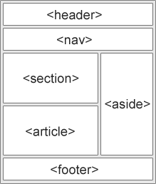
Semantic Elements in HTML
In HTML there are some semantic elements that can be used to define different parts of a web page:
Tag | Description
<article> | Defines independent, self-contained content
<aside> | Defines content aside from the page content
<details> | Defines additional details that the user can view or hide
<figcaption> | Defines a caption for a <figure> element
<figure> | Specifies self-contained content, like illustrations, diagrams, photos, code listings, etc.
<footer> | Defines a footer for a document or section
<header> | Specifies a header for a document or section
<main> | Specifies the main content of a document
<mark> | Defines marked/highlighted text
<nav> | Defines navigation links
<section> | Defines a section in a document
<summary> | Defines a visible heading for a <details> element
<time> | Defines a date/time

Slide 5
HTML <section> Element
<!DOCTYPE html>
<html>
<body>
<section>
<h1>WWF</h1>
<p>The World Wide Fund for Nature (WWF) is an international organization working on issues regarding the conservation, research and restoration of the environment, formerly named the World Wildlife Fund. WWF was founded in 1961.</p>
</section>
<section>
<h1>WWF's Panda symbol</h1>
<p>The Panda has become the symbol of WWF. The well-known panda logo of WWF originated from a panda named Chi Chi that was transferred from the Beijing Zoo to the London Zoo in the same year of the establishment of WWF.</p>
</section>
</body>
</html>

Slide 6
EXAMPLE of Semantic Element :
<!DOCTYPE html>
<html> <body>
<nav>
<a href="/html/">HTML</a> |
<a href="/css/">CSS</a> |
<a href="/js/">JavaScript</a> |
<a href="/jquery/">jQuery</a>
</nav>
<p>My family and I visited The Epcot center this summer. The weather was nice, and Epcot was amazing! I had a great summer together with my family!</p>
<figure>
<img src="https://en.wikipedia.org/wiki/File:Shadow_of_Mordor_cover_art.jpg" alt="Shadow of Mordor" />
<figcaption>Cover art for Middle-earth: Shadow of Mordor</figcaption>
</figure>
<aside>
<h4>Epcot Center</h4>
<p>Epcot is a theme park at Walt Disney World Resort featuring exciting attractions, international pavilions, award-winning fireworks and seasonal special events.</p>
</aside>
<details>
<summary>Epcot Center</summary>
<p>Epcot is a theme park at Walt Disney World Resort featuring exciting attractions, international pavilions, award-winning fireworks and seasonal special events.</p>
</details>
</body>
</html>

Slide 7
HTML <audio> Tag & < video >
The HTML5 <audio> and <video> tags make it simple to add media to a website. You need to set src attribute to identify the media source and include a controls attribute so the user can play and pause the media.
<!DOCTYPE html>
<html> <body>
<h1>The audio element</h1>
<p>Click on the play button to play a sound:</p>
<audio controls>
<source src="horse.ogg" type="audio/ogg">
<source src="horse.mp3" type="audio/mpeg">
Your browser does not support the audio element.
</audio>
</body>
</html>

Slide 8
HTML Tag < video >
<!DOCTYPE html>
<html>
<body>
<h1>The video element</h1>
<video width="320" height="240" controls>
<source src="movie.mp4" type="video/mp4">
<source src="movie.ogg" type="video/ogg">
Your browser does not support the video tag.
</video>
</body>
</html>

Slide 9
MORE ATTRIBUTES:
Attribute | Value | Description
autoplay | autoplay | Specifies that the video will start playing as soon as it is ready
controls | controls | Specifies that video controls should be displayed (such as a play/pause button etc).
height | pixels | Sets the height of the video player
loop | loop | Specifies that the video will start over again, every time it is finished
muted | muted | Specifies that the audio output of the video should be muted
poster | URL | Specifies an image to be shown while the video is downloading, or until the user hits the play button
preload | auto metadata none | Specifies if and how the author thinks the video should be loaded when the page loads
src | URL | Specifies the URL of the video file
width | pixels | Sets the width of the video player

Slide 10
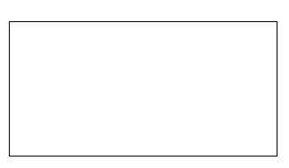
What is HTML Canvas?
The HTML <canvas> element is used to draw graphics, on the fly, via JavaScript.
The <canvas> element is only a container for graphics. You must use JavaScript to actually draw the graphics.
Canvas has several methods for drawing paths, boxes, circles, text, and adding images.
<!DOCTYPE html>
<html>
<body>
<canvas id="myCanvas" width="200" height="100" style="border:1px solid #000000;">
Your browser does not support the HTML canvas tag.
</canvas>
</body>
</html>

Slide 11
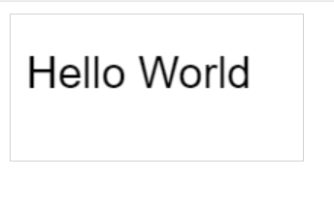
Canvas example
<!DOCTYPE html>
<html>
<body>
<canvas id="myCanvas" width="200" height="100" style="border:1px solid #d3d3d3;">
Your browser does not support the HTML canvas tag.</canvas>
<script>
var c = document.getElementById("myCanvas");
var ctx = c.getContext("2d");
ctx.font = "30px Arial";
ctx.fillText("Hello World",10,50);
</script>
</body>
</html>

Slide 12
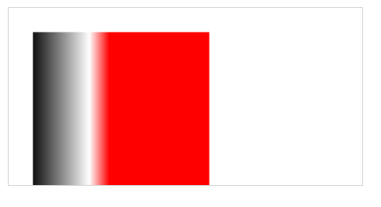
Example of Canvas
<!DOCTYPE html>
<html>
<body>
<canvas id="myCanvas" width="300" height="150" style="border:1px solid #d3d3d3;">
Your browser does not support the HTML5 canvas tag.</canvas>
<script>
var c = document.getElementById("myCanvas");
var ctx = c.getContext("2d");
var my_gradient = ctx.createLinearGradient(0,0,170, 0,);
my_gradient.addColorStop(0.1, "black");
my_gradient.addColorStop(0.4, "white");
my_gradient.addColorStop(0.5, "red");
ctx.fillStyle = my_gradient;
ctx.fillRect(20, 20, 150, 600);
</script>
</body>
</html>

Slide 13
Why CSS?
With CSS you can create good-looking websites with nice effects.
With CSS you can control the text (like font, color, size, etc.), and the layout (like backgrounds, margin, padding, etc.) of a website, in one single style sheet file!
With CSS you save a lot of work!

Slide 14
What is CSS?
CSS stands for Cascading Style Sheets
It is a style sheet language
It is used to describe the presentation (that is, the look and formatting) of a document written in a markup language
CSS allows you to define the styles (e.g. fonts, colors, spacing) to apply to your web document
CSS enables the separation of document content (written in HTML/XHTML) from document presentation and layout

Slide 15
Why Was CSS Created?
HTML was intended to define the content of a document, like:
<p>This is a paragraph.</p>
<h1>This is a heading</h1>
HTML was never intended to contain tags for formatting a document.
When tags like <font> and color attributes were added to HTML, development of large web sites, where fonts and color information were added to every single page, became a long and expensive process.
To solve this problem, the World Wide Web Consortium (W3C) created CSS.
With CSS, all formatting could be removed from the HTML document, and stored in a separate CSS file.
All browsers support CSS today.

Slide 16
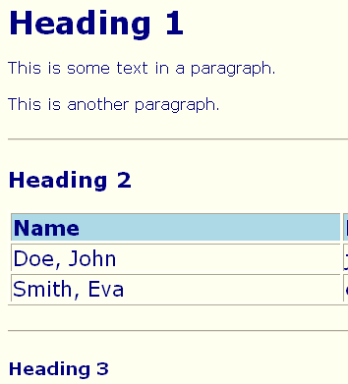
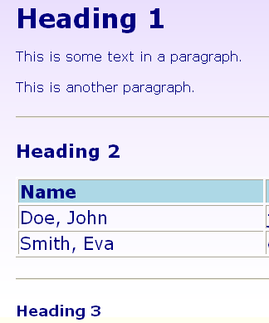
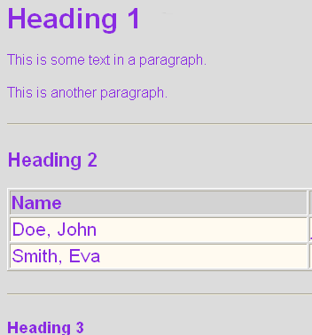
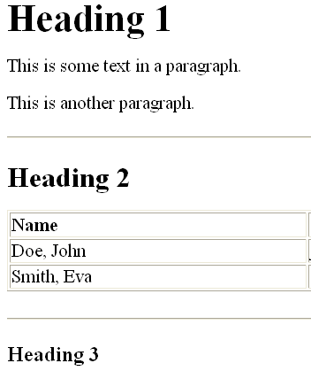
Applying CSS
Document without styles
With Style 1
With Style 2
With Style 3

Slide 17
CSS Syntax
The CSS syntax is made up of three parts:
a selector, a property and a value
selector {property:value}
The selector is normally the HTML element/tag you wish to define
The property is the attribute you wish to change
Each property can take a value
The property and value are separated by a colon, and surrounded by curly braces:

Slide 18
CSS Syntax...
p
p {color: red;}
{
color: red;
}
Selector
Property
Value
The Property specifies a characteristic, such as color, font-family, position
The Value expresses specification of a property, such as red for color, arial for font family, 12 pt for font-size

Slide 19
CSS Syntax...
Note:
If the value is multiple words, put quotes around the value:
p {font-family:"sans serif"}
If you want to specify more than one property, separate each property with a semicolon.
p {text-align:center; color:red}
To make the style definitions more readable, describe one property on each line.
p { text-align:center; color:black; font-family:arial }

Slide 20
Grouping Selectors
You can group selectors. Separate each selector with a comma.
In the example below, all header elements will be displayed in blue text color:
h1,h2,h3,h4,h5,h6,p { color:blue }

Slide 21
Example
<html>
<head>
<style type="text/css">
p
{
text-align:center;
color:black;
font-family:arial
}
h1,h2,h3,h4,h5,h6
{
color:blue
}
</style>
</head>
contd...

Slide 22
Example...
<body>
<H1>Bad Beginning </H1>
<p> NO ONE CAN GO BACK AND CHANGE A BAD BEGINNING, <br/> BUT ANYONE CAN START NOW AND CREATE A SUCCESFUL ENDING
</p>
<h2>Successful Ending </h2>
</body>
</html>

Slide 23
The class Selector
With the class selector you can define different styles for the same type of HTML element.
To have two types of paragraphs in your document: one right-aligned paragraph, and one center-aligned, define two styles:
p.right {text-align:right} p.center {text-align:center}
Use the class attribute in your HTML document to apply the style
<p class="right">This paragraph will be right-aligned.</p>
<p class="center">This paragraph will be center-aligned.</p>

Slide 24
The class Selector...
Note: Class names are user-defined identifiers/names
To apply more than one class per given element, the syntax is:
<p class="center bold">This is a paragraph.</p>
The paragraph above will be styled by the
class "center" AND the class "bold".

Slide 25
The class Selector...
You can also omit the HTML tag name in the selector to define a style that will be used by all HTML elements that have the class.
.center {text-align:center}
In the example below, all HTML elements with class="center" will be center-aligned:
<h1 class="center">This heading will be center-aligned</h1> <p class="center">This paragraph will also be center- aligned.</p>

Slide 26
<html>
<head>
<style type="text/css">
p.right {text-align:right; }
p.center {text-align:center; }
.green{ color:#00FF00;}
</style>
</head>
<body>
<H1>Bad Beginning </H1>
<p class="right green"> NO ONE CAN GO BACK AND CHANGE A BAD BEGINNING, <br/> BUT ANYONE CAN START NOW AND CREATE A SUCCESFUL ENDING
</p>
<p class="center"> NO ONE CAN GO BACK AND CHANGE A BAD BEGINNING, <br/> BUT ANYONE CAN START NOW AND CREATE A SUCCESFUL ENDING
</p>
<h2 class="green">Successful Ending </h2>
</body>
</html>
Example

Slide 27
The id Selector
You can also define styles for HTML elements with the id selector. The id selector is defined as a #.
The style rule below will match the element that has an id attribute with a value of "green":
#green_heading {color:green}
The style rule below will match the p element that has an id with a value of "para1":
p#para1 { text-align:center; color:red }

Slide 28
Example
<html>
<head>
<title>Internal CSS Linking</title>
<style type="text/css">
p {text-align:right; color:blue }
p#para1 {text-align:center; color:red }
#green_heading{ color:#00FF00;}
</style>
</head>
<body>
<H1 id="green_heading" >Bad Beginning </H1>
<p> NO ONE CAN GO BACK AND CHANGE A BAD BEGINNING, <br/> BUT ANYONE CAN START NOW AND CREATE A SUCCESFUL ENDING </p>
<p id="para1"> NO ONE CAN GO BACK AND CHANGE A BAD BEGINNING, <br/> BUT ANYONE CAN START NOW AND CREATE A SUCCESFUL ENDING </p>
<p> NO ONE CAN GO BACK AND CHANGE A BAD BEGINNING, <br/> BUT ANYONE CAN START NOW AND CREATE A SUCCESFUL ENDING </p>
<h2>Successful Ending </h2>
</body>
</html>

Slide 29
Methods of CSS Linking
There are three methods of applying CSS to an HTML document.
External style sheet
Internal style sheet
In-line styles

Slide 30
External Style Sheet
An external style sheet is most suitable when the style is applied to many pages.
With an external style sheet, you can change the look of an entire Web site by changing one file.
Each page must link to the style sheet using the <link> tag. The <link> tag goes inside the head section:
<head> <link rel="stylesheet" type="text/css" href="mystyle.css" /> </head>
The browser will read the style definitions from the file mystyle.css, and format the document according to it.
An external style sheet can be written in any text editor. The file should not contain any html tags. The style sheet should be saved with a .css extension.

Slide 31
Example - External Style Sheet
<html> default.html
<head>
<title> External CSS Example </title>
<link rel="stylesheet" type="text/css" href="style.css" /> </head>
<body>
<h1>This is a page with red background and white text </h1>
</body>
</html>
body {background-color: red; color: white; } style.css

Slide 32
Internal Style Sheet
An internal style sheet should be used when a single document has a unique style.
You define internal styles in the head section by using the <style> tag
Example:
<head>
<style type="text/css">
p {text-align:right; }
H1 {text-align:center; }
h2{ color:#00FF00;}
</style>
</head>

Slide 33
Inline Styles
An inline style loses many of the advantages of style sheets by mixing content with presentation.
This method should be used when a style is to be applied to a single occurrence of an element.
To use inline styles you use the style attribute in the relevant tag.
The style attribute can contain any CSS property.
Example:
<p style="color:blue;margin-left:15px">This is a paragraph.</p>

Slide 34
Inline Styles...
<html>
<head>
<title>Inline CSS Style</title>
</head>
<body style="background-color: red; color: white ">
<H1>This is a page with red Background and white text color </H1>
</body>
</html>

Slide 35
Cascading Order
What style will be used when there is more than
one style specified for an HTML element?
The styles "cascade" into a new "virtual" style sheet by the following rules, where number four has the highest priority:
Browser default
External style sheet
Internal style sheet (in the head section)
Inline style (inside an HTML element)

Slide 36
Cascading Order...
An inline style (inside an HTML element) has the highest priority, which means that it will override a style defined inside the <head> tag, or in an external style sheet, or in a browser (a default value).
Note: If the link to the external style sheet is placed after the internal style sheet in HTML <head>, the external style sheet will override the internal style sheet!

Slide 37
Reference :
https://www.w3schools.com/html/default.asp
https://www.w3schools.com/css/default.asp

Slide 38
Exercises
Show a we page to show semantic elements.
Create a web page to add a audio and video.
Create a simple inline CSS to change body properties to color red and background color blue.
Create a simple webpage with image gallery use internal CSS to change the image properties.
Create a table 2x 3 using html use external CSS change the properties.

